Slide 1

NOVEMBER 15TH, 2023
RUHS-BH : HELP@HAND MHSA INNOVATION PROJECT
Suzanna Juarez-Williamson, Administrative Services Manager
& Yuniar Praheswari, Research Specialist II
RUHS-BH Evaluation Unit

Slide 2

HELP@HAND LEARNING OBJECTIVES
1 | Detect and acknowledge mental health symptoms sooner
2 | Reduce stigma associated with mental illness by promoting mental wellness
3 | Increase access to appropriate level of support and care
4 | Increase purpose, belonging and social connectedness of individuals served
5 | Analyze and collect data to improve mental health needs assessment and service delivery

Slide 3
Program Evaluation
Help@Hand Innovation projects require Data Collection and Program Evaluation:
Feasibility of using A4i in community mental health clinics
Consumer utilization and benefits from using A4i
Sharing lessons learned and recommendations on continuing A4i use beyond the pilot initiative.
The questions on the Program Evaluation are focused on process data and impacts for users. Basic process data includes the overall use of A4i, while its impacts are focused on perceived usefulness, efficacy and effectiveness off the A4i app.

Slide 4
Key Evaluation Questions
Consumers experience with A4i likeability, usefulness of features, successful adoption (frequency of use, retention rate).
Evaluate increases in social connectedness, well-being, sense of connection to care team, and symptom reduction.
Evaluate the impact of using A4i on consumers setting goals and goal attainment.
Evaluate the extent to which the A4i technology can be used to detect changes in mental health status that would prompt care team staff to initiate an intervention.

Slide 5
Technology Use Survey
Evaluation Survey Measures
Current Technology Use
Well Being, Sense of Social Connectedness
Quality of Life Survey
Mental Health Functioning
Symptom Reduction
BASIS-24® Scale
A4i User Experience
Survey
Consumers’ Ratings of A4i
App Features

Slide 6
Evaluation Measures
Survey Data Collection Schedule
Intake Packet
3 Months Follow-Up
6 Months Follow-Up
Technology Use Survey
A4i Experience Survey
A4i Experience Survey
Quality of Life Scale
Quality of Life Scale
Quality of Life Scale
BASIS-24 Symptom Measure
BASIS-24 Symptom Measure
BASIS-24 Symptom Measure

Slide 7
A4i PILOT PARTICIPANTS
TOTAL ENROLLED:
102 Consumers
In Progress or Discontinued
In Progress
Graduated Pilot
21 completed 1-Month
31 completed 3-Months
50 completed 6-Months Pilot
9 withdrew after 1 month
4 completed 3 months and then withdrew
3 dropped and then re-enrolled and completed Pilot

Slide 8
Participant Demographics (N= 102)
GENDER
53.9% Male, 42.2% Female
AGE
78% 26 to 59 years
17.6% TAY 16-25 years

Slide 9
Technology Use Survey-All Participants (N = 102)
Consumers regularly used various technology:
88% use a Smartphone
54% use Phone Apps
58% also use a Laptop/Desktop computer
62% spent 6+ hours on their Smartphone using Apps or going online in a week
52% go online to look up mental health information
63% have not used a mental health app but were interested in using one

Slide 10

Using App Data to Understand Engagement
Engagement with A4i Sound Detector
Summary of A4i Engagement
Engagement
In A4i Features
A4i App and Portal Activity
Posting to A4i Newsfeed
App4Independence
Newsfeed
Check-Ins
Other Features
Total Engagement
Sherry Luo, MEMOTEXT
Support. Predict. Impact.
A4i App use data analyzed and provided by MEMOTEXT (Sherry Luo, Data Analyst)

Slide 11
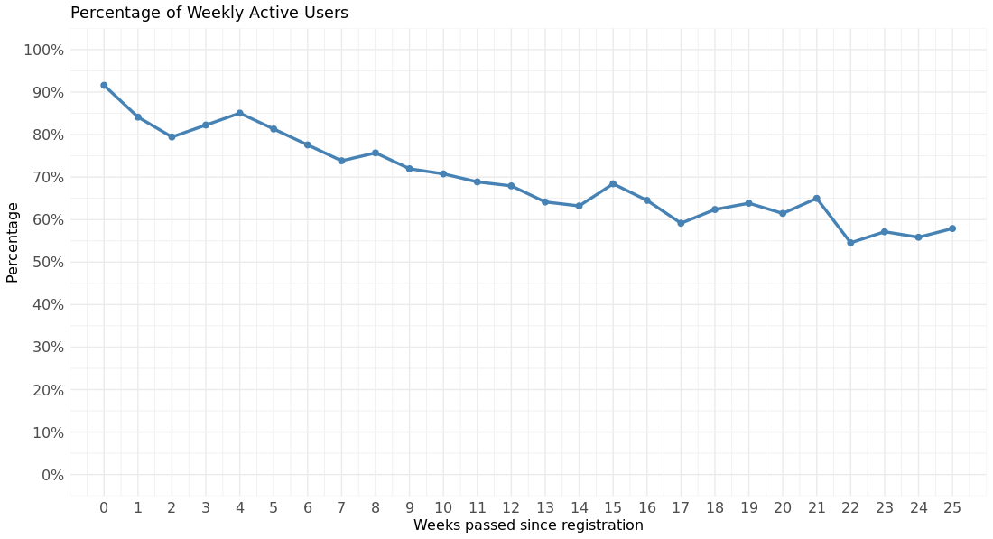
Summary of A4i Engagement Data
Percentage of Weekly App Use Across Weeks in the Pilot
Average across time is about 70% engagement each week
A4i App use data analyzed and provided by MEMOTEXT (Sherry Luo, Data Analyst)

Slide 12
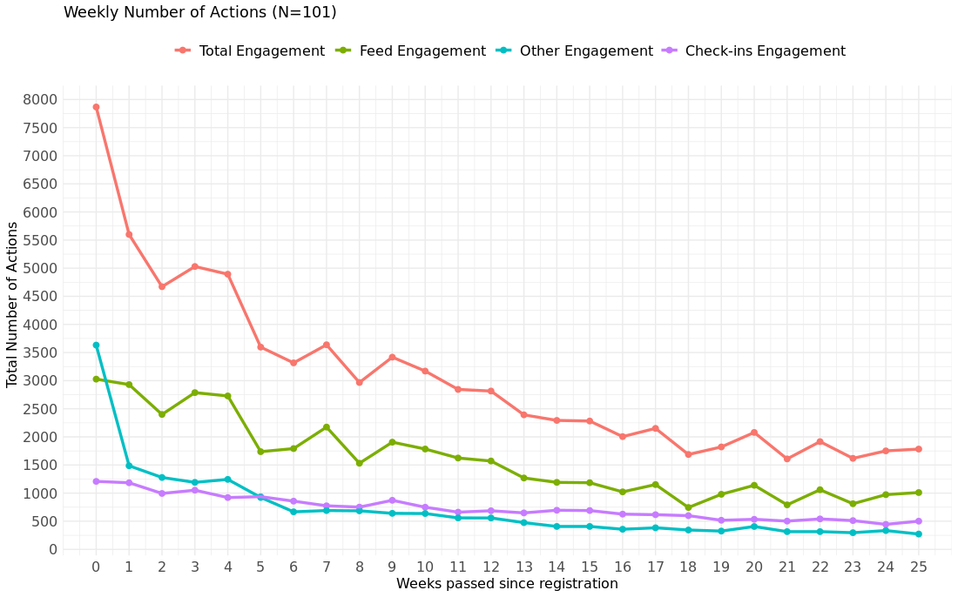
A4i Engagement Data by Feature
Weekly Number of Actions (n = 101)
Newsfeed Feature has the highest Engagement
A4i App use data analyzed and provided by MEMOTEXT (Sherry Luo, Data Analyst)

Slide 13
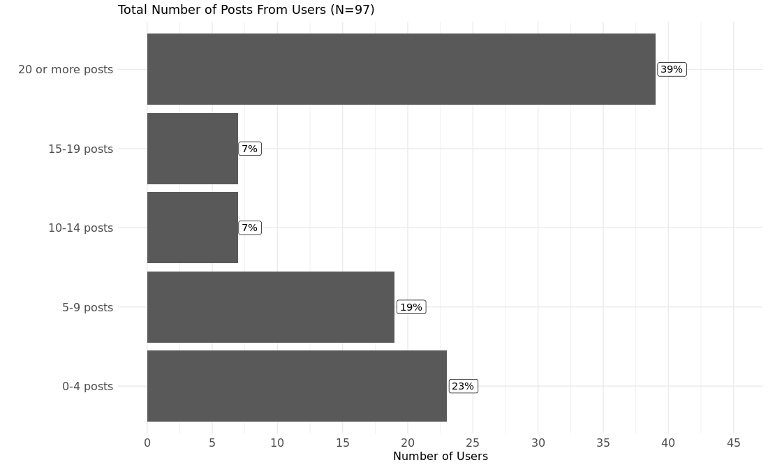
Consumer A4i Newsfeed Posting
Total Number of Posts From Users (n = 97)
20 or More Posts
39%
“This particular part of the app has a lot to build a little community, you know, of support amongst each other.” -
Consumer quote
15 to 19 Posts
7%
96%
Posted at Least Once
10 to 14 Posts
7%
5 to 9 Posts
19%
0 to 4 Posts
23%
A4i App use data analyzed and provided by MEMOTEXT (Sherry Luo, Data Analyst)

Slide 14
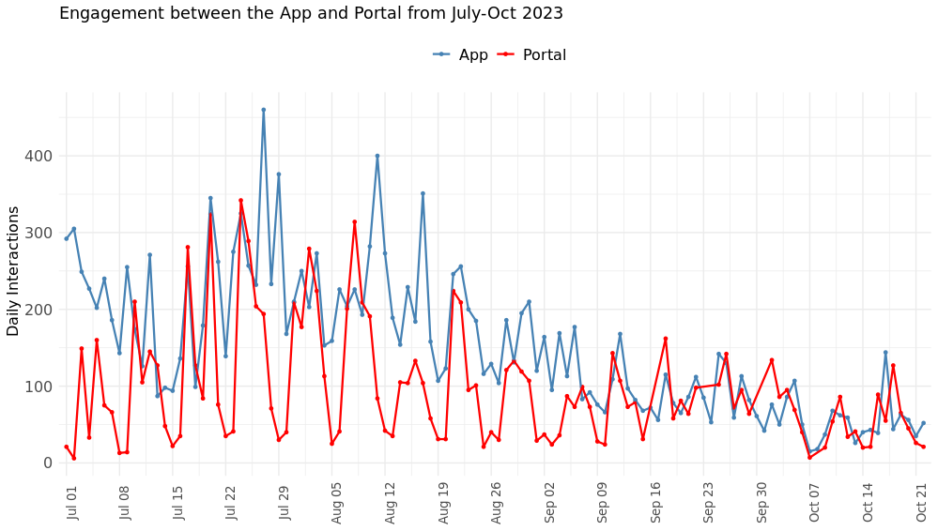
A4i App and Portal Activity
Percentage of Weekly App Use Across Weeks in the Pilot from July to October 2023
Displays the daily activities from app users and Peer Support Specialist from July to October 2023.
Note the positive correlation as the app and portal activity move in tandem.
High engagement in the portal corresponds to high engagement in the app.
A4i App use data analyzed and provided by MEMOTEXT (Sherry Luo, Data Analyst)

Slide 15
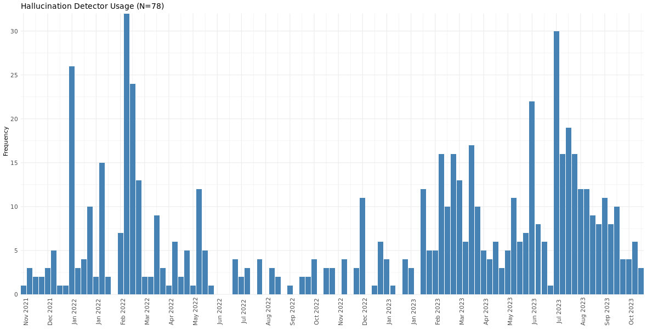
A4i Engagement with Sound Detector
Hallucination Detector Usage (n = 97)
Sound Detector Use (n=97)
78 participants have engaged with the Sound Detector tool at least once.
Sound Detector tool was consistently and frequently used
A4i App use data analyzed and provided by MEMOTEXT (Sherry Luo, Data Analyst)

Slide 16
Quality of Life Survey Results
Improved Satisfaction in….
Life as a whole 67%
Emotional Well-Being 84%
Personal Relationships 44%
Being part of a community 71%
Time spent with other people 57%
Increase
in Satisfaction
Decrease
in
Dis-Satisfaction
n = 50 Pilot Graduates

Slide 17
A4i User Experience Survey Results

Slide 18
A4i User Experience Survey Results
n = 50 Pilot Graduates
Notes:
This figure shows more of what consumers thought about A4i use. These items focused on basic app functionality did it work was it easy to use.
This graph shows the percentages of graduated pilot participants who Agreed or Strongly Agreed to the survey items on A4i Ease of Use App. Easy to Use and Language was clear and easy to understand had the highest endorsement at 92% of consumers.
More than 88% agreed or strongly agreed it was easy to find information and easy to navigate the A4i App.
Nearly 3 quarters of the consumer found the app visually appealing and 72% agreed that it rarely crashed.
Only 26% felt that as a result of using A4i, others know more about them more than they are comfortable with

Slide 19
A4i User Experience Survey Results

Slide 20
A4i User Experience Survey Results

Slide 21
A4i User Experience Survey Results

Slide 22
BASIS-24 Scale Results from Graduated Participants
BASIS-24:Pre to Post Measurement (n = 50)
*
*
*
*
* Statistically significant results (p<=.05)

Slide 23
Other Items Analyzed in A4i User Experience Survey Results Graduated Pilot Participants (n = 50)
Content and Security
Costs of Using A4i
Culture and Values
Notes Feature
88% A4i values and respects cultural differences
Only 40.8% felt that A4i demonstrates knowledge about their culture, while 44.9% felt neutral
76% trust A4i with their personal information
88% felt the information on A4i is credible and trustworthy
96% felt that the content in A4i is appropriate for them
94% felt they have the resources necessary to use A4i App
Only 16% felt concerned about the costs associated with using A4i App
82% felt the Notes feature on the A4i App was easy to use
Only 50% used the Notes feature often, while 30% felt neutral about using the Notes feature

Slide 24

Feedback from Participants
NEWSFEED COMMENT
“It reminds me of a mental health Facebook, kind of. It's cool because everybody who's on this app has some mental health challenges, and we're here to see that people are doing good. It makes me feel better about myself knowing that if they can get through it, I can too.”
SOUND DETECTOR
“I really like this feature. It's very helpful and accurate. I use it about four times a day. I wasn't sure what was real and what was not. I try it different times of the day on different things I've wondered about”

